Slide 1


Computational Metastasis Lab
Dr. Nima Maftoon (Systems Design Engineering, University of Waterloo)
February 7, 2019

Slide 2
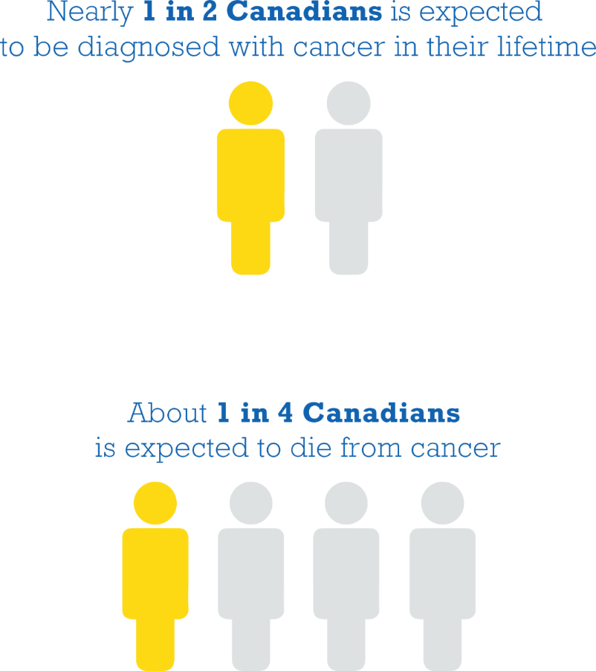
Why should we care?
Canadian Cancer Statistics Advisory Committee, Canadian Cancer Statistics 2018.

Slide 3
Why should we care?
2017 estimates¹:
Over 200,000 Canadians were diagnosed with cancer
Over 80,000 died from it
90% of cancer deaths is due to metastasis^{2,3}.
¹ Canadian Cancer Statistics Advisory Committee. Canadian Cancer Statistics 2018.
² Wittekind C, Neid M, Cancer invasion and metastasis. Oncology. 2005; 69 Suppl 1:14-6
³ Chaffer CL, Weinberg RA, Science. 2011 Mar 25; 331(6024):1559-64.

Slide 4
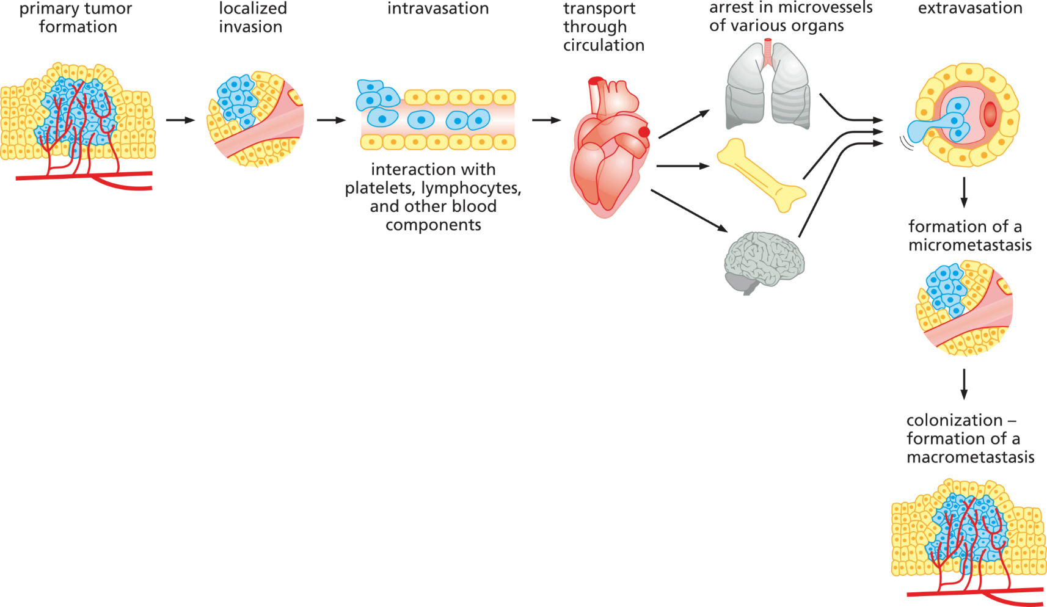
What is metastasis
Weinberg, The Biology of Cancer, Garland Science, 2014

Slide 5
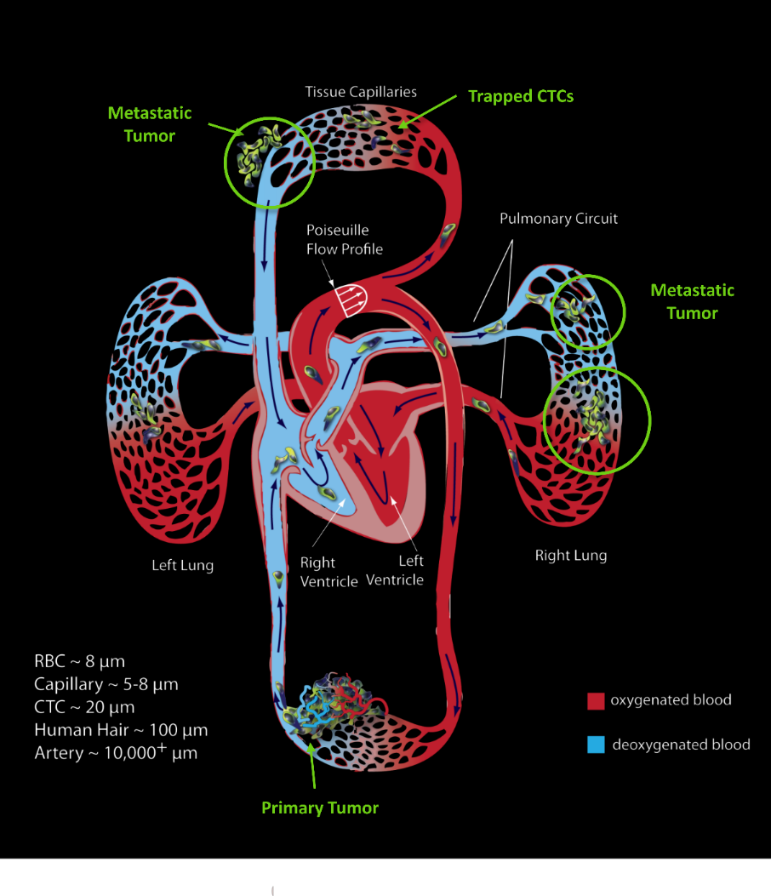
What is metastasis
Newton, et al. (2012) A Stochastic Markov Chain Model to Describe Lung Cancer Growth and Metastasis. PLOS ONE 7(4): e34637.

Slide 6
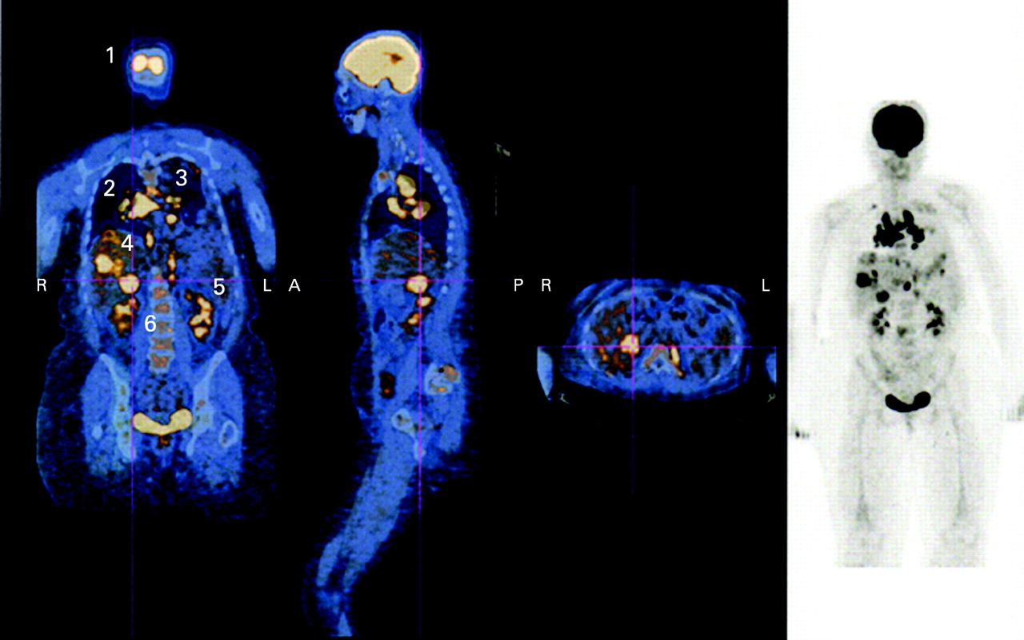
PET/CT image revealing metastases in the nasal fossa (1), lungs (2), mediastinal lymph nodes (3), liver (4), peritoneal cavity (5) and lumbar vertebrae (6).
M Kurli et al. Br J Ophthalmol 2008;92:479-482, ©2008 by BMJ Publishing Group Ltd.

Slide 7
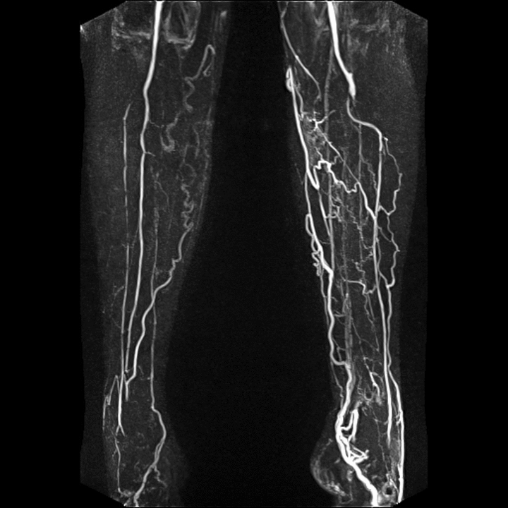
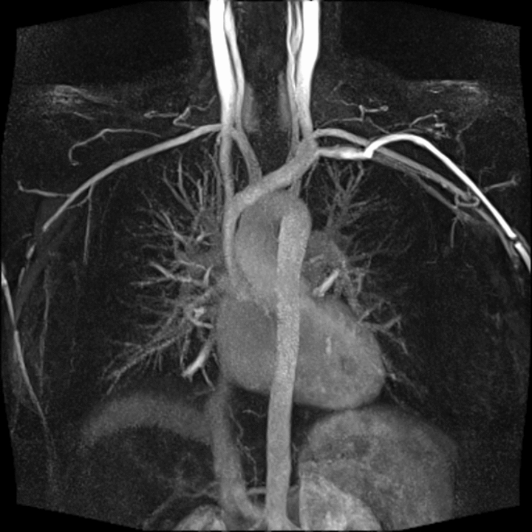
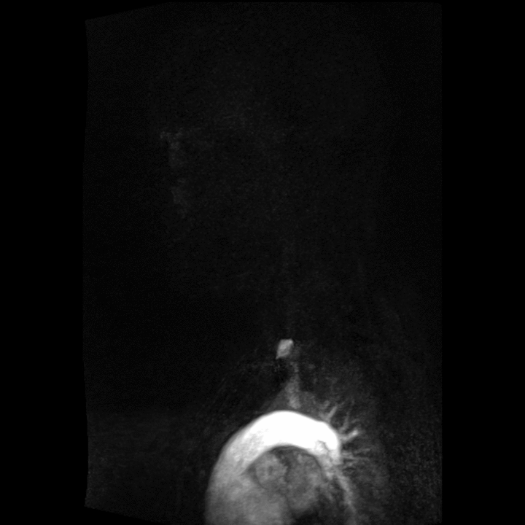
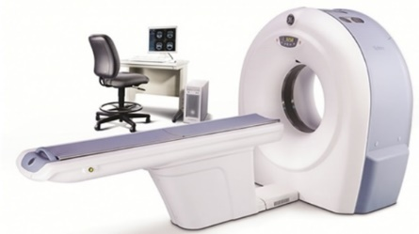
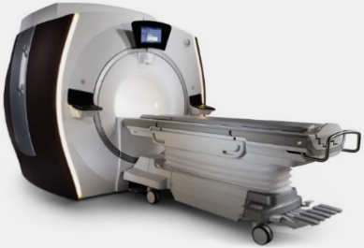
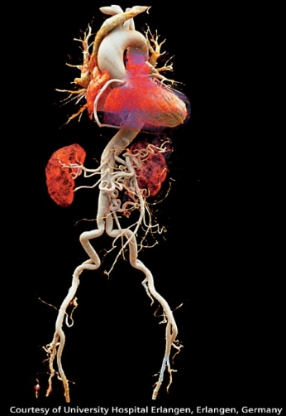
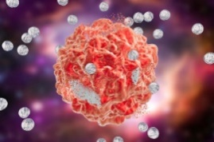
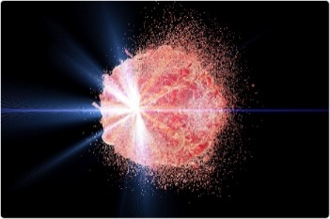
The big idea
Imaging modalities
Courtesy of Siemens
Predictive module
Predicts secondary tumor sites for each individual patient
Computational fluid and solid mechanics-based:
Multiscale
Particulate flow
Circulating Tumor Cells deformation
Automatic 3-D reconstruction module
CT: Brivo CT315 GE Healthcare
MR: Discovery™ MR750w GEM
Effective monitoring: early diagnosis
Targeted drug delivery
Targeted radiotherapy
Novel precision therapies

Slide 8
Application for cancers of unknown primary
Most important factor for patient outcome: determination of primary*
Survival time improves if therapy is specific rather than general broad-spectrum chemotherapy*
*Greco, F. (2012). Cancer of unknown primary site: evolving understanding and management of patients. Clinical Advances in Hematology and Oncology 10, 518-524.

Slide 9
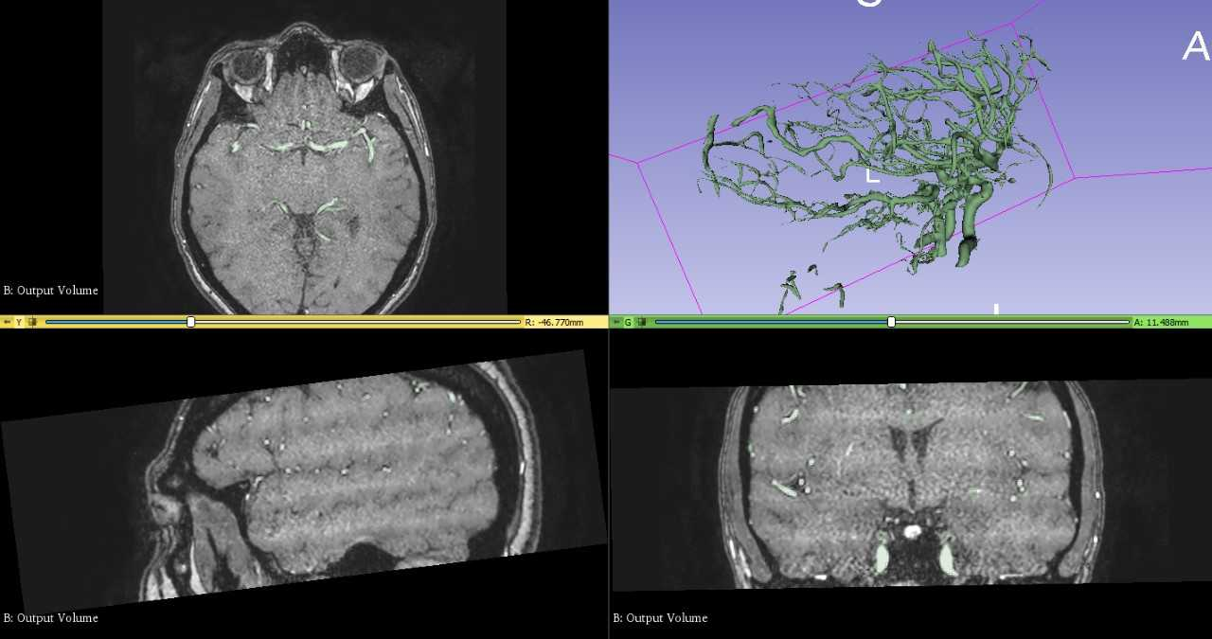
Components developments

Slide 10

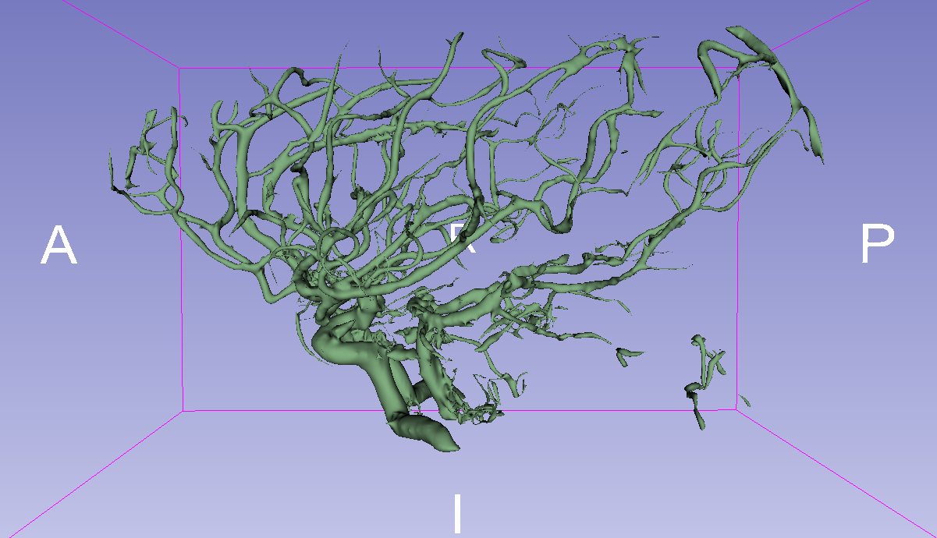
Components developments
Tumor Cell deformation
Tumor Cell adhesion
Tumor Cell translocation
Strategies for vascular disconnection & multiscale modelling
Lattice-Boltzmann method in junction templates

Slide 11

Computational Metastasis Lab: a vehicle for collaboration help us with your excellence

Slide 12
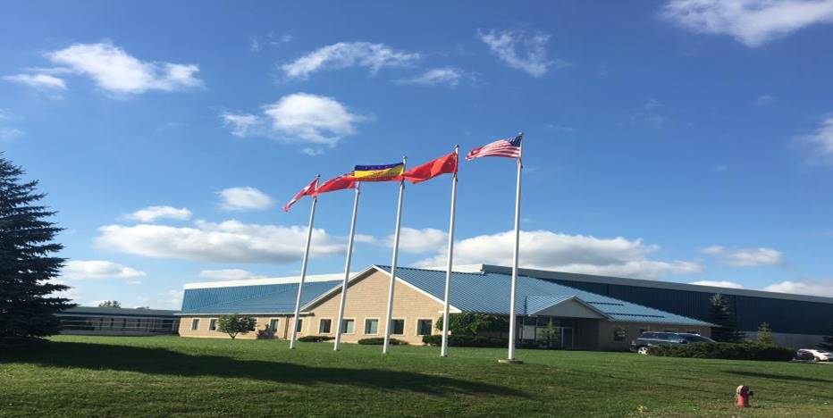
Industrial partner: Northernchem Inc.
High-tech company focused on medicine and life science technologies
Northernpharm Inc. founded in 2009
Northernchem Inc. founded in 2012
In Niagara Falls Ontario

Slide 13
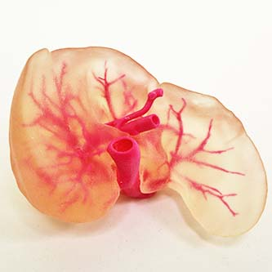
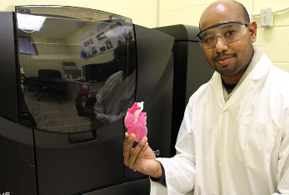


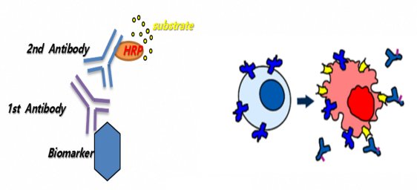
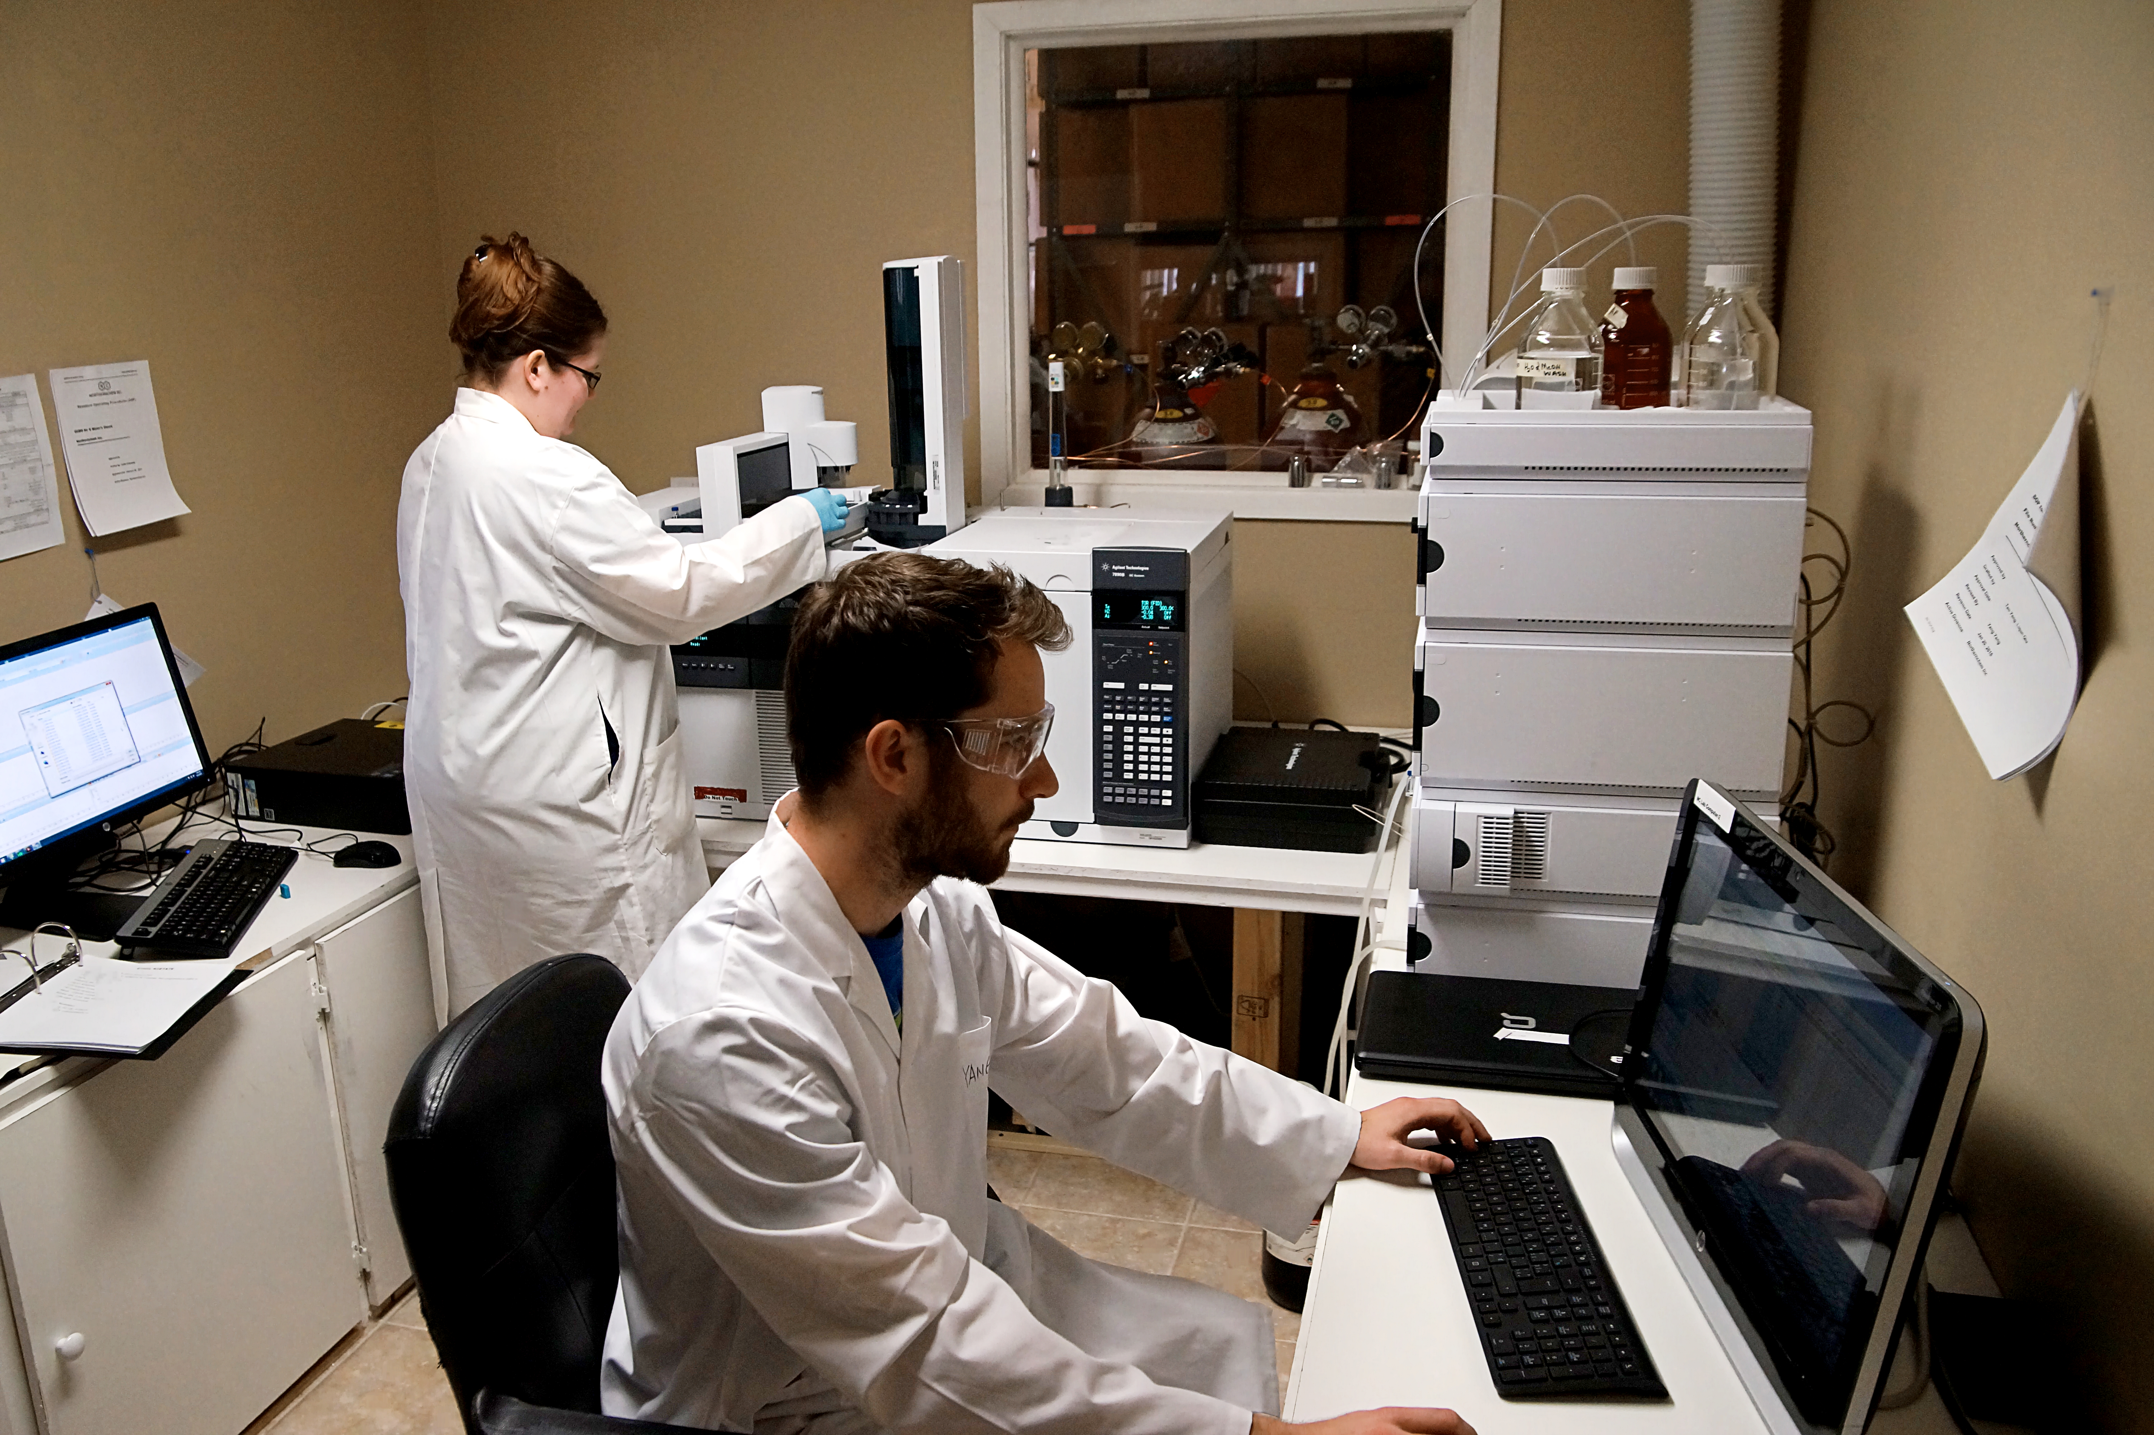
Industrial partner: Northernchem Inc.
R&D:
Early stage cancer and disease tests
New drug R&D
New technologies for generic drugs
New API compounds
3D printing and 3D bioprinting
Stem cell growth and applications
Natural products
3D Printing
New Drug Research
Generic Drugs
Early Stage Cancer Test

Slide 14
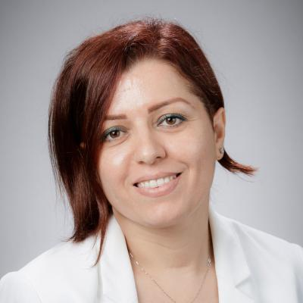
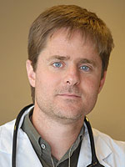
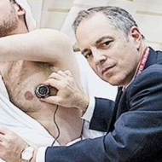
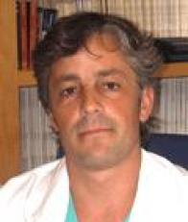

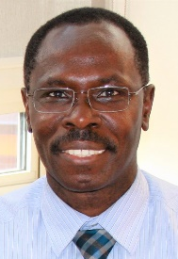

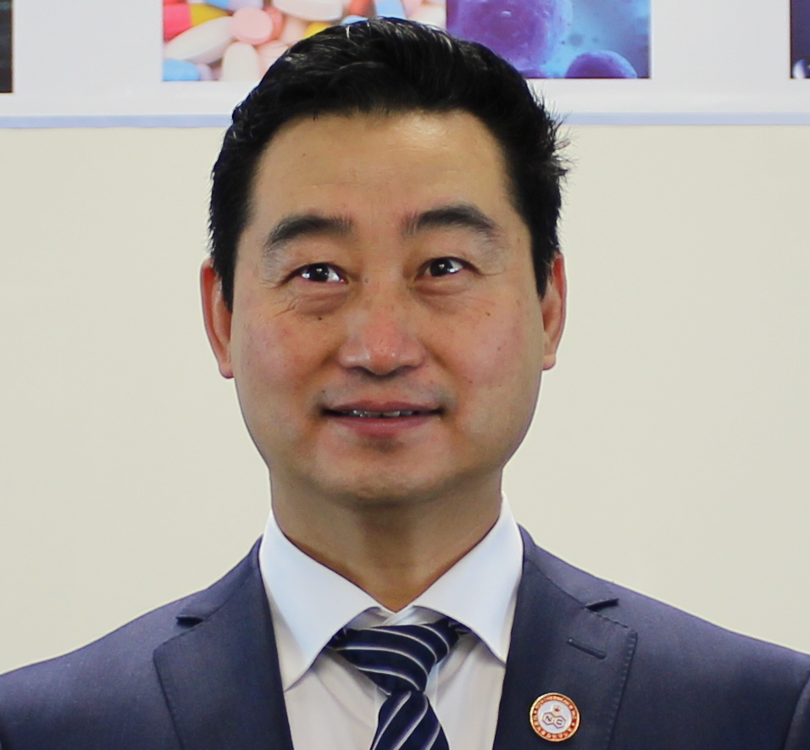
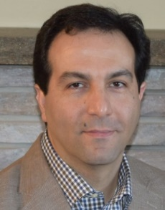
Multidisciplinary approach
Dr. Zahra Motamed
McMaster university
Computational Fluid Dynamics, 3D reconstruction
Dr. Javier Ganame
McMaster university
Clinical Sciences
Dr. Elazer R Edelman
Harvard Medical School, MIT
Clinical Sciences
Dr. Jose M. de la Torre Hernandez (Hospital Universitario Marques de Valdecilla , Spain) Clinical Sciences
Dr. Julio Garcia
University of Calgary
Clinical Imaging
GRH Team:
Dr. Ernest Osei
Medical physicist
Dr. Johnson Darko
Medical physicist
Dr. Daniel Glick
Radiation Oncologist
Dr. Nima Maftoon
University of Waterloo
Computational Fluid and Solid Mechanics, 3D reconstruction, Software development
Dr. Jun Pang
CEO Northernchem Inc.
Drug delivery
Cancer diagnosis

Slide 15

Thank you

